Slide 1
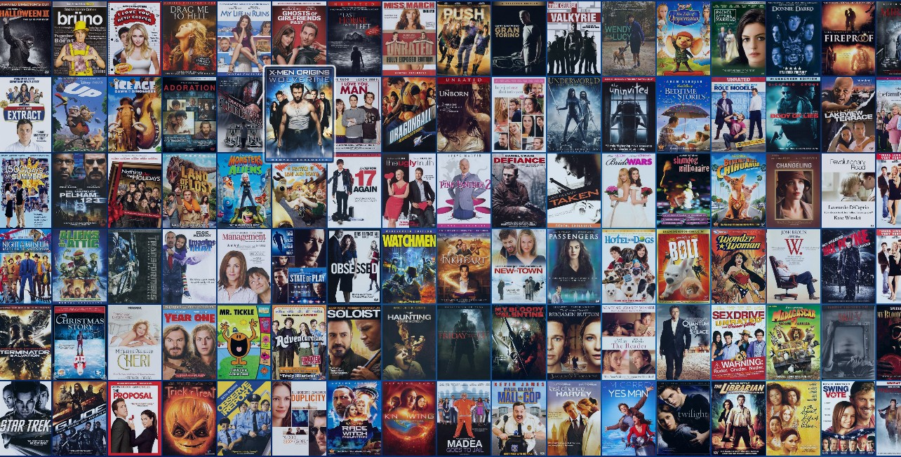

Video Recommendation Engines
Capstone Project (08/11/21)
Presented by: Victoria Loo

Slide 2
Agenda
1
Biography
2
Business Context
3
Project Pipeline
4
Data Science Process
- Define, Design, Delivery
5
Summary
- Next Steps & Future Improvements

Slide 3

Biography
Education:
Data Science from Institute of Data
Bachelor Degree in Pharmacy from Monash University
Experience:
Aged Care Pharmacist
Community Pharmacist
Skills:
Machine Learning
Deep Learning
Data Mining
Victoria Loo
linkedin.com/in/victorialoo

Slide 4

What should I watch tonight?

Slide 5
Agenda
1
Biography
2
Business Context
3
Project Pipeline
4
Data Science Process
- Define, Design, Delivery
5
Summary
- Next Steps & Future Improvements

Slide 6
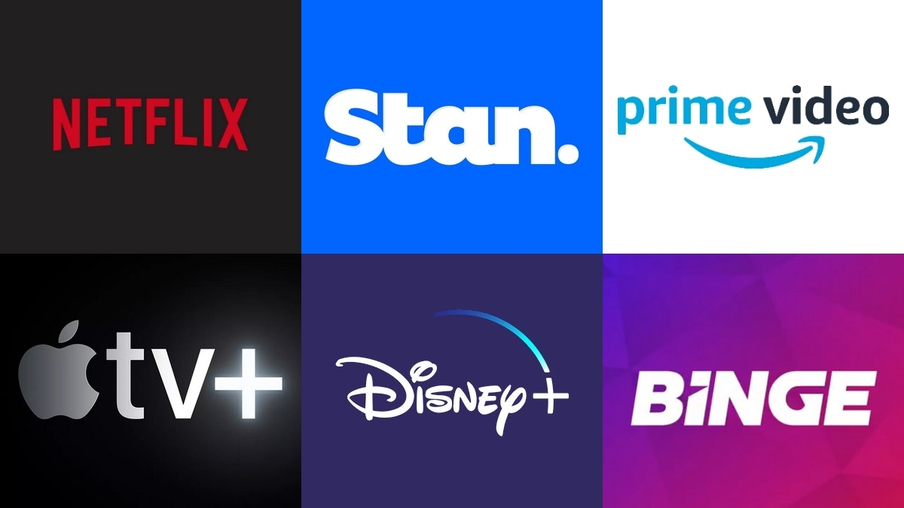
RECOMMENDATION ENGINE in Entertainment & Media Industry
OVERVIEW
In the past, recommendations would come from a salesperson or friends and family.
Widely used in all video streaming platforms.
Use algorithms and data analysis techniques to recommend most relevant videos to a particular customer.
Netflix has valued its recommendation engine a yearly $1 billion worth. Why?
BENEFITS
Boost customer engagement
Increase business revenue
Improve subscription loyalty and reduce churn rate
Deliver more personalized customer experiences

Slide 7
Global Entertainment Industry Revenue
in 2020
$2 TRILLION USD

Slide 8
Agenda
1
Biography
2
Business Context
3
Project Pipeline
4
Data Science Process
- Define, Design, Delivery
5
Summary
- Next Steps & Future Improvements

Slide 9
Stakeholders
1. CEO: Julian Ogrin 2. Executive Director: Alison Hurbert-Burns 3. Executive Management Committee
Business Question
Business Answer
Project Pipeline
Data Question
Data Answer
Data Science Process
Model
Deployment
Data
Data
Acquisition
Exploratory
Data Analysis
Data
Pre-processing
Model Building & Evaluation

Slide 10
Agenda
1
Biography
2
Business Context
3
Project Pipeline
4
Data Science Process
- Define, Design, Delivery
5
Summary
- Next Steps & Future Improvements

Slide 11
Data Question
i. Define
Business Question
How can we offer personalised recommendations that are tailored to every customer unique preference and boost subscription loyalty?
What models can we develop and use to offer personalised recommendations to each customer?

Slide 12

i. Define
Data Overview
Data Source: Kaggle https://www.kaggle.com/grouplens/movielens-20m-dataset
1,048,575
Data collected from MovieLens (a movie recommendation service company)
Data created by 7120 users.
Users have rated 27,278 movies. On average, each user have rated at least 20 movies.
Movies were released between
year 1900-2015.
Movies are categorised into 19 types of movie genres.
Number of Ratings (i.e. observations)
7,120
27,278
Number of Users
Number of Movies
19
1900-2015
Number of Genres
Movie Year Range

Slide 13
ii. Design
Exploratory Data Analysis
Most movies have at least above 4.0 rating.
Thriller is the most popular genre rated by users.
Number of movies released increases every year.

Slide 14
TYPES OF RECOMMENDATION MODELS
iii. Deliver
1
Content Based Filtering
NON-PERSONALISED RECOMMENDATION
2
Collaborative Filtering
3
Hybrid Content-Collaborative Filtering
PERSONALISED RECOMMENDATION
4
Deep Learning

Slide 15
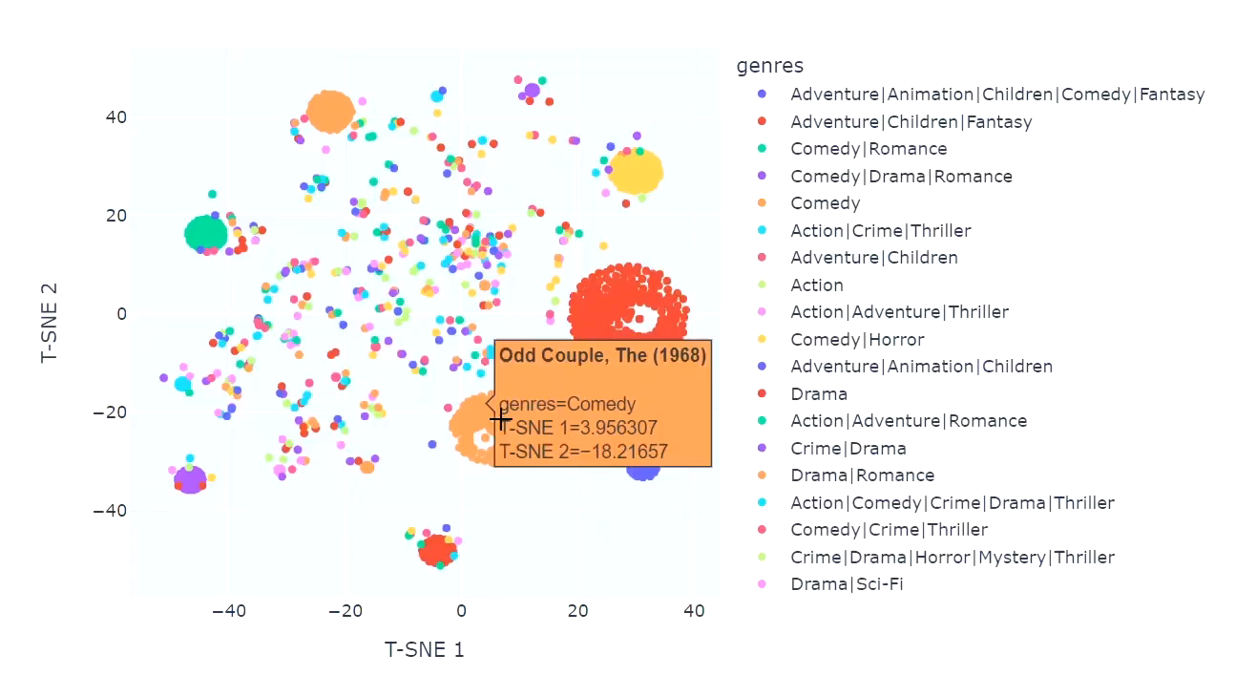
Content-Based Filtering
iii. Deliver
1
A system that makes recommendations based on similarities in features.
Uses ML algorithms to find movies with similar genres to movies the user have liked in the past.
Apply NLP and T-SNE techniques.
Photo above is a visualization of the model.
Each circle represents a movie.
Movies of the same genres will group together.

Slide 16
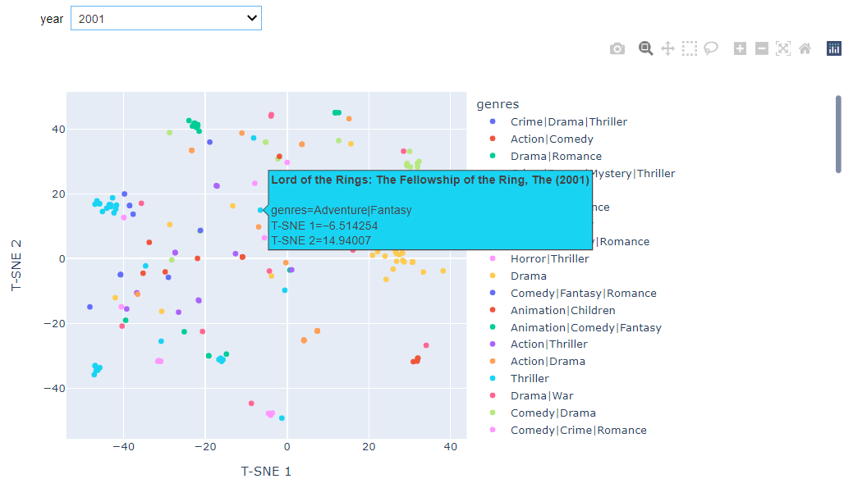
Content-Based Filtering
iii. Deliver
1
Optional feature: categorise movies into years.
Users can find similar movies in the same year.

Slide 17
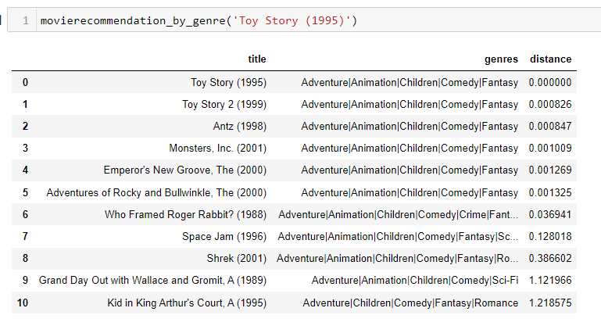
Content-Based Filtering
iii. Deliver
1
Find the top 10 most similar movies by calculating the Euclidean distance between two movies on T-SNE graph.
Example: User A likes the movie ‘Toy Story 1995’, model will find more movies with similar genres.

Slide 18
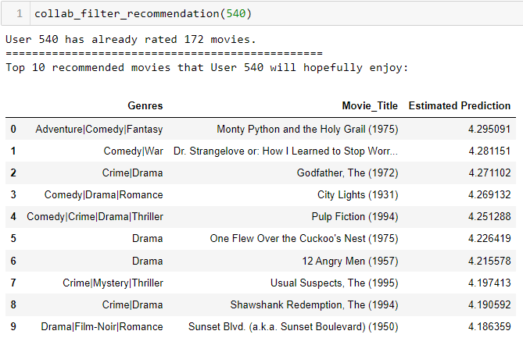
Collaborative-Based Filtering
iii. Deliver
2
A system that relies on the past data interactions between users and movies they have watched.
Apply Singular Value Decomposition (SVD) technique.
Choice of Evaluation Metric is Root Mean Square Error (RMSE).
Example: if User 1 watches movie A, B, C, and User 2 watches movie A, C, the model will recommend movie A and C to a similar User 3.
Average RMSE is 0.8623.

Slide 19
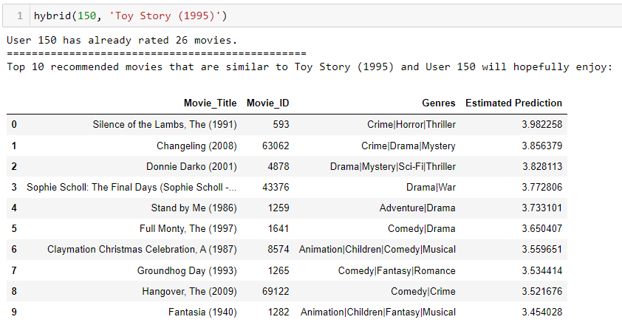
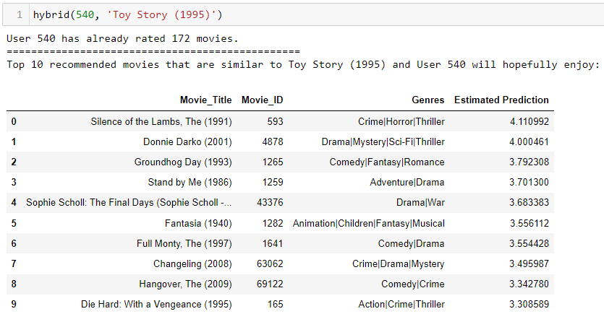
Hybrid Filtering
iii. Deliver
3
(Content-Collaborative Based)
Combines algorithms of both Content-Based and Collaborative Filtering.
Makes recommendations based on the movie preferences of similar users (collaborative filtering) and movies with similar genres that a user has rated highly (content-based filtering)

Slide 20
Deep Learning
iii. Deliver
4
The overall model architecture
Movie_ID Input Layer
User_ID Input Layer
Movie Embedding Layer
User Embedding Layer
Reshape
Deep Neural
Network
Apply Deep Neural Network with Keras.
This system relies on the user data to make recommendations.
By utilising embedding and dense layers, the network is able to find better combinations between users and movies, which result in more accurate rating predictions of movies (i.e. lower RMSE).
Concatenate reshaped embedding layers
Add one Dense layer
Dropout Regularisation
Model Fit & Train
Test Model
Recommend Movies

Slide 21
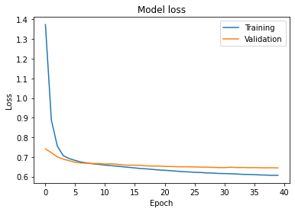
Deep Learning
iii. Deliver
4
Average RMSE on test data is 0.8022.
Best epoch at 40, with minimum RMSE 0.8009.

Slide 22
Agenda
1
Biography
2
Business Context
3
Project Pipeline
4
Data Science Process
i. Define, ii. Design, iii. Delivery
5
Summary
- Conclusion & Next Steps

Slide 23




Conclusion
All four models were successful at making video recommendations.
Best performing models for the business are Hybrid model and Deep Neural Network model.
Content-Based Filtering
Recommends movies with similar genres.
But user may or may not like the movies.
Collaborative-Based Filtering
Recommends movies that a user is likely to rate higher based on watch history of similar users.
But movies recommended may have very different genres.
Hybrid Content-Collaborative Based
Best of both worlds!
Recommends movies similar to a particular movie and that the user is likely to rate high.
Deep Neural Network
Provides better movie recommendations compare to Collaborative-Based Filtering model. Average RMSE was relatively lower.

Slide 24
Next steps
Deploy model to gain real-time customer feedbacks
Collect additional demographic based information about users to further enhance models.
Perform a deep neural network on hybrid model to further lower RMSE, provide more accurate movie recommendations.

Slide 25
THANK YOU !

